Slide 1
COCA Call Information
For the best quality audio, we encourage you to use your computer’s audio.
Webinar link: https://zoom.us/j/915683484
If you cannot join through digital audio, you may join by phone in listen-only mode:
US: 1(646) 876-9923 or 1(669) 900-6833
Webinar ID: 915 683 484
All questions must be submitted through the webinar system via the Q&A button. Please do not ask a question using the chat button.

Slide 2
Outbreak of 2019 Novel Coronavirus (2019- nCoV)—Interim Guidance for Clinicians
Clinician Outreach and Communication Activity (COCA) Webinar
Friday, January 31, 2020

Slide 3
Continuing Education
No Continuing Education is provided for this COCA Call.

Slide 4
To Ask a Question
Using the Webinar System
Click on the Q&A button in the Zoom webinar system.
Type your question in the Q&A box.
Submit your question.
Please do not submit a question using the chat button.
For media questions, please contact CDC Media Relations at
404-639-3286 or send an email to media@cdc.gov.
If you are a patient, please refer your questions to your healthcare provider.

Slide 5
Today’s Presenters
Aron Hall, DVM, MSPH 2019-nCoV Response Epidemiology Task Force Deputy Lead
National Center for Immunization and Respiratory Diseases
Centers for Disease Control and Prevention
Will Weldon, PhD 2019-nCoV Response Laboratory Task Force Lead
National Center for Immunization and Respiratory Diseases
Centers for Disease Control and Prevention
Timothy Uyeki, MD, MPH, MPP
2019-nCoV Response Clinical Team Lead
National Center for Immunization and Respiratory Diseases
Centers for Disease Control and Prevention
Ryan Fagan, MD, MPH&TM
2019-nCoV Response Healthcare Infection Control Team Lead
National Center for Emerging and Zoonotic Infectious Diseases
Centers for Disease Control and Prevention

Slide 6
CDC Resources
2019 Novel Coronavirus Website: www.cdc.gov/novelcoronavirus
Interim Guidance for Healthcare Professionals: https://www.cdc.gov/coronavirus/2019-nCoV/hcp/clinical-criteria.html
Interim Clinical Guidance for Management of Patients with Confirmed 2019 Novel Coronavirus (2019-nCoV) Infection: https://wwwdev.cdc.gov/coronavirus/2019-ncov/hcp/clinical-guidance-management-patients.html
Interim Guidelines for Collecting, Handling, and Testing Clinical Specimens from Patients Under Investigation (PUIs) for 2019 Novel Coronavirus (2019-nCoV)—aka Guidelines for Clinical Specimens: https://www.cdc.gov/coronavirus/2019-nCoV/lab/guidelines-clinical-specimens.html
Interim Infection Prevention and Control Recommendations for Patients with Known or Patients Under Investigation for 2019 Novel Coronavirus (2019-nCoV) in a Healthcare Setting—aka Guidelines for Infection Prevention and Control: https://www.cdc.gov/coronavirus/2019-nCoV/hcp/infection-control.html

Slide 7
To Ask a Question
Using the Webinar System
Click on the Q&A button in the Zoom webinar system.
Type your question in the Q&A box.
Submit your question.
Please do not submit a question using the chat button.
For media questions, please contact CDC Media Relations at
404-639-3286 or send an email to media@cdc.gov.
If you are a patient, please refer your questions to your healthcare provider.

Slide 8
Today’s Webinar Will Be Available On-Demand
When: A few days after the live call
What: Video with closed captioning
Where: On the COCA Call webpage at
https://emergency.cdc.gov/coca/calls/2020/callinfo_013120.asp

Slide 9
COCA Products & Services
COCA Call Announcements contain all information subscribers need to participate in COCA Calls. COCA CallCOCA Call Announcements contain all information subscribers need to participate in COCA Calls. COCA Calls are held as needed.
s are held as needed.
COCA Call Announcements contain all information subscribers need to participate in COCA Calls. COCA Calls are held as needed.
Monthly newsletter that provides information on CDC training opportunities, conference and training resources, the COCA Partner Spotlight, and the Clinician Corner.
As-needed messages that provide specific, immediate action clinicians should take. Contains comprehensive CDC guidance so clinicians can easily follow recommended actions.

Slide 10
COCA Products & Services
Monthly newsletter that provides updates on emergency preparedness and response topics, emerging public health threat literature, resources for health professionals, and additional information important during public health emergencies and disasters.
Informs clinicians of new CDC resources and guidance related to emergency preparedness and response. This email is sent as soon as possible after CDC publishes new content.
CDC's primary method of sharing information about urgent public health incidents with public information officers; federal, state, territorial, and local public health practitioners; clinicians; and public health laboratories.

Slide 11
Join COCA’s Mailing List
Receive information about:
Upcoming COCA Calls
Health Alert Network (HAN) messages
CDC emergency response activations
Emerging public health threats
Emergency preparedness and response conferences and training opportunities
http://emergency.cdc.gov/coca

Slide 12
Join Us on Facebook

Slide 13
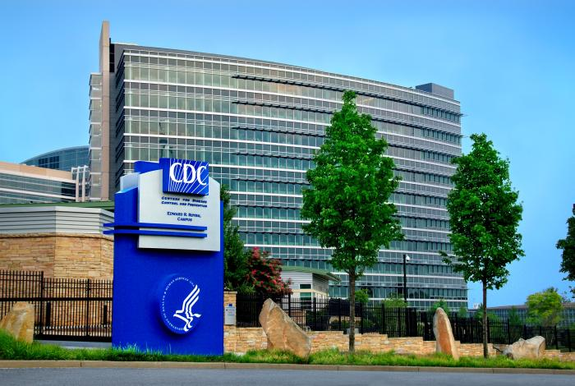
Thank you for joining us today!
http://emergency.cdc.gov/coca

